Slide 1

Festival Technology

Slide 2
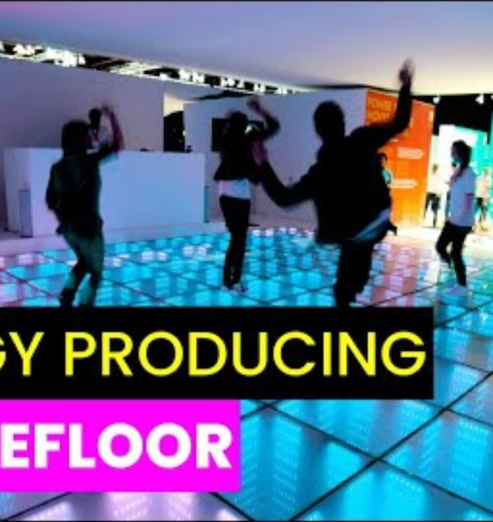
Kinetic Energy Dance Floor
Implement a dance floor that generates power from people's movements, which is then used to fuel the light show, creating a sustainable entertainment experience.

Slide 3
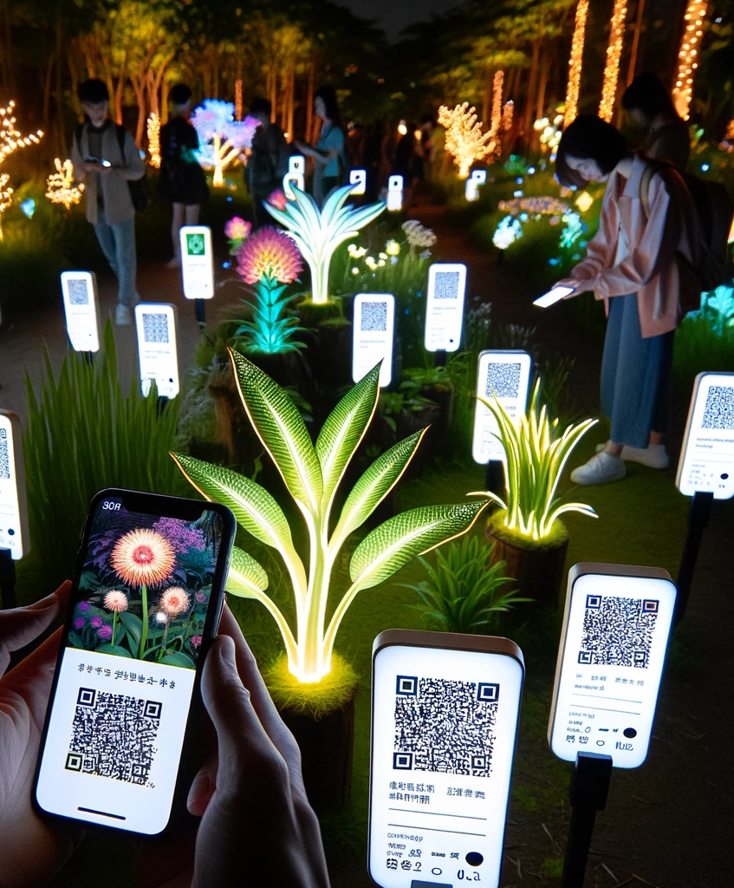
Glowing Plant Markers
LED markers next to plant exhibits that charge during the day and glow at night. Each marker can provide QR codes or NFC tags for visitors to learn more about the specific plant species, their ecological roles, and conservation status. visualize and this procces

Slide 4
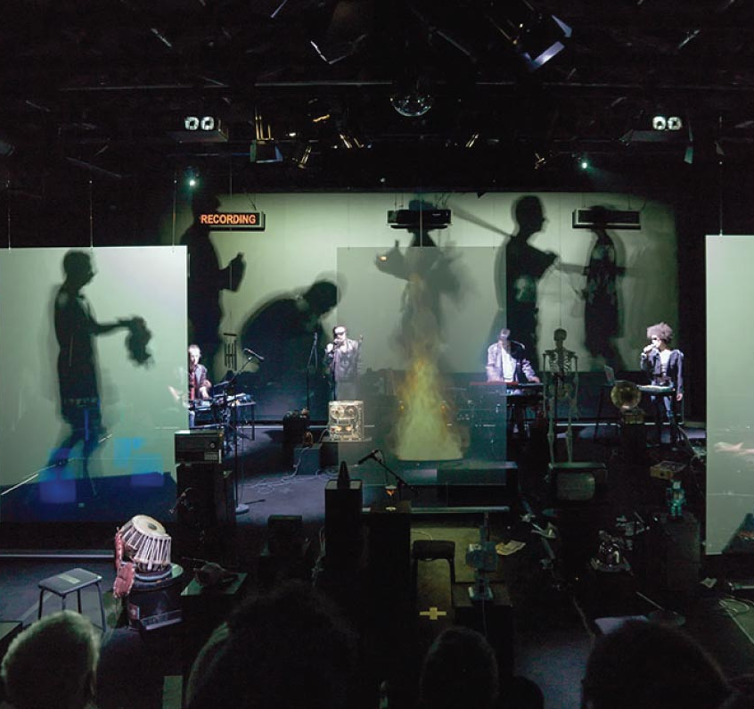
Holographic Performance Stage
Set up a stage that uses holographic technology to project lifelike performances, providing an innovative visual spectacle.

Slide 5
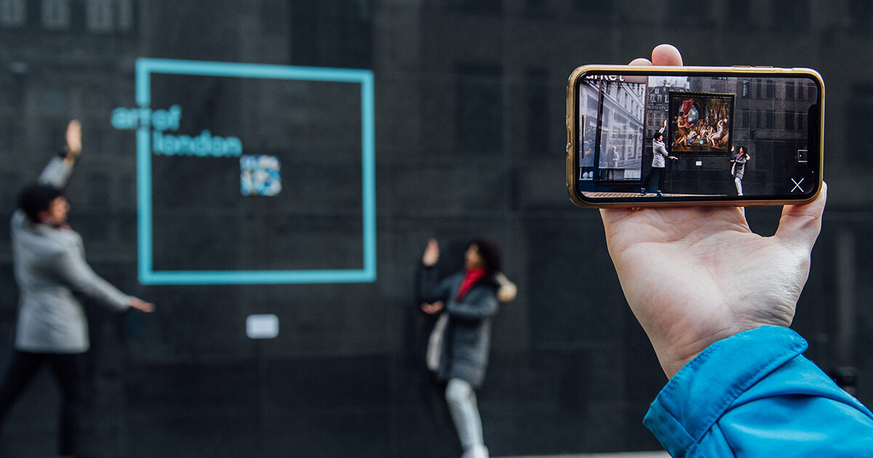
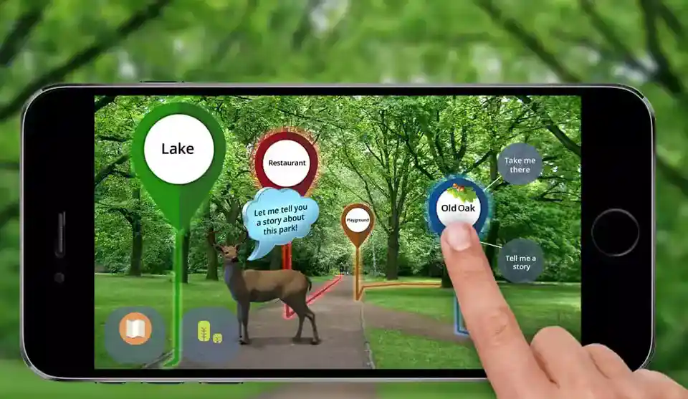
Augmented Reality Art Walk
Create an art walk where visitors can use AR via their smartphones to see additional digital elements superimposed on the physical artworks, enhancing the overall experience

Slide 6
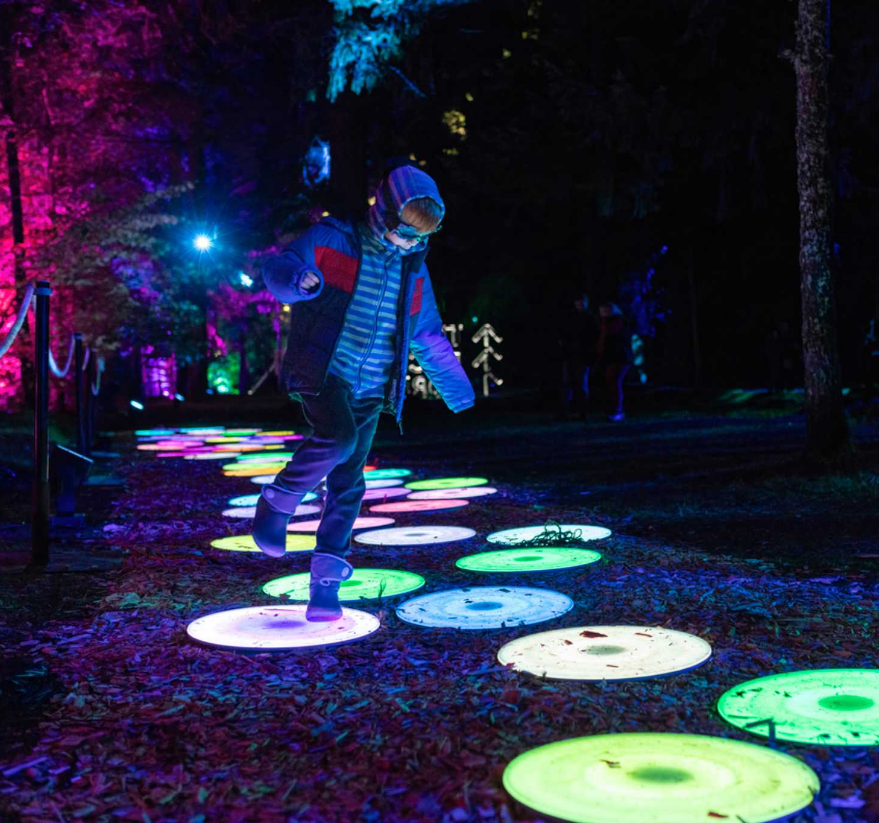
Interactive Light and Sound Pathway
Interactive Light and Sound Pathway: Design a pathway that uses motion sensors to trigger lights and sounds, creating a dynamic and interactive experience for visitors as they walk through different themed sections.

Slide 7
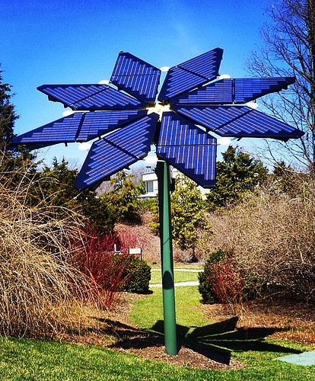
Solar-Powered Art Installations
Utilize solar panels on sculptures and artworks that store energy during the day and light up at night, offering an eco-friendly artistic display.

Slide 8
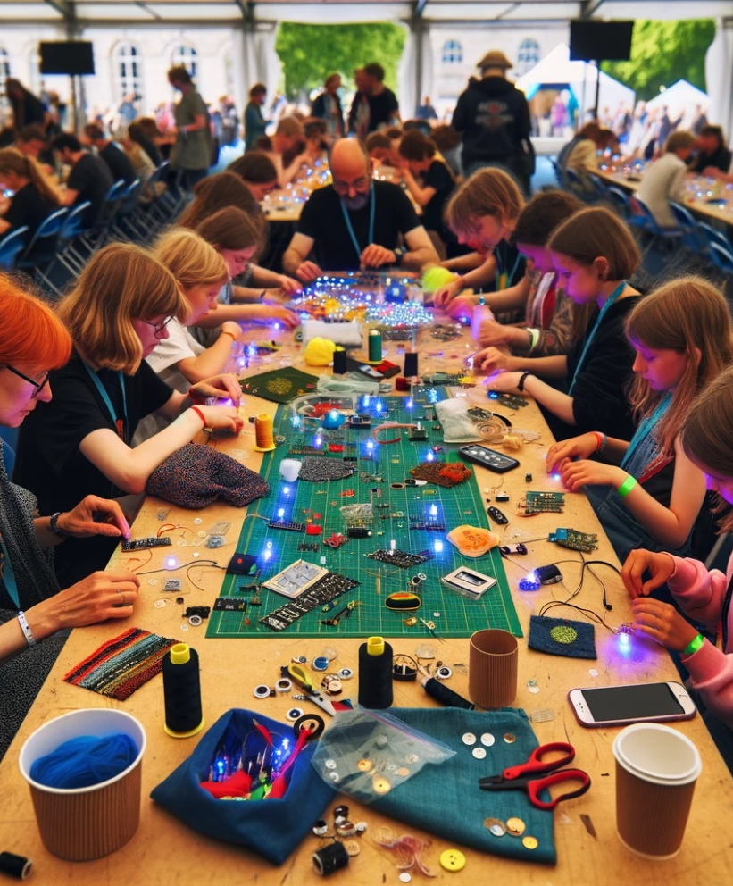
E-Textile Workshop
This interactive workshop invites attendees to personalize their festival gear. With guidance, participants can embed LEDs and use conductive thread to sew electronic circuits directly into their clothing, creating wearable pieces of light art.

Slide 9

Product benefits
Guarantee of success

